Slide 1

DIAGNO AI
Get yourself diagnosed within Seconds
360 CODE CRAFT
INNOVACION
IEM, KOLKATA

Slide 2
Problem statement
HEALTHCARE PROBLEM STATEMENT
AI-POWERED SYMPTOM CHECKER
Problem: Many people self-diagnose using the internet, which often leads to misinformation and anxiety.
Challenge: Develop an AI-based chatbot or mobile app that allows users to input their symptoms and receive a preliminary diagnosis based on verified medical data.
Importance: Such kind of problems are valid in today’s world of digitalization, as we all know Internet has its own good and bad ways.We have created a system which gives you accurate and fast diagnosis for your disease, which gives the patient clarity about his/her state and enough time to react to the disease.

Slide 3

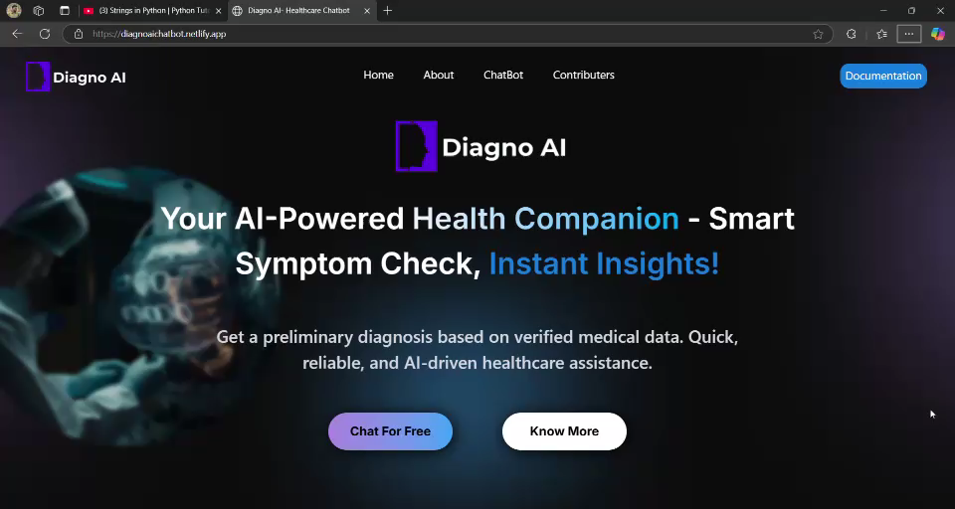
Working model demo

Slide 4
TECHNOLOGIES USED
Node js
React
Vite
Figma
Tailwind CSS
Gemini API

Slide 5

Solution & Challenges Faced

Slide 6
Solution Overview
Our solution is an AI-Powered ChatBot designed to provide accurate and fast disease diagnosis based on user-reported symptoms.
The chatbot utilizes verified medical data and GEMINI API to minimize misinformation and improve diagnostic reliability.
Fast Diagnosis: Provides instant preliminary results based on symptoms.
Accurate Analysis: Uses AI models trained on medical datasets for better precision.
User-Friendly Interface: Simple chatbot-based interaction for ease of use.
Scalability: Can be expanded with more medical conditions and integrations.

Slide 7
Key features
AI-Powered Symptom Analysis – Utilizes the Gemini API to assess symptoms and provide health insights.
Interactive Chatbot Interface – Engaging and easy-to-use chatbot for seamless user interaction.
Smart Follow-Up Questions – Asks users about symptom duration, severity, and medical history for better analysis.
Preliminary Health Guidance – Suggests possible conditions based on symptoms but does not provide a definitive diagnosis.
Next-Step Recommendations – Offers advice on monitoring symptoms, home remedies, or consulting a healthcare professional.
Emergency Detection – Advises users to seek immediate medical help if symptoms indicate a serious condition.
Healthcare-Only Assistance – Strictly responds to medical queries and informs users it cannot assist with non-medical topics.

Slide 8
Challenges & Learnings
Data Accuracy & Reliability: Ensuring the AI chatbot uses only trusted medical sources to avoid misinformation.
AI Model Training: Training the model with diverse datasets to improve diagnosis precision.
User Experience: Designing an intuitive and engaging chatbot interface for seamless interaction.
Ethical & Legal Considerations: Addressing potential misdiagnosis risks and ensuring compliance with healthcare regulations.
Gained expertise in AI-driven healthcare solutions.
Understood the importance of data quality and bias mitigation in AI models.
Improved skills in natural language processing (NLP) and chatbot development.

Slide 9
Contributor’s names
TEAM NAME: HACKTASTICS
Ansubha Dhar( Full stack)
Ankit Hazra(Full stack)
Adipto Purakayastha(UI/UX Designing)
Abhimanyu Ganguly(API Testing & Documentation)
Anish Ghosh( Frontend & Documentation)

